Slide 1

Relationship between BMI and health indicators

Slide 2
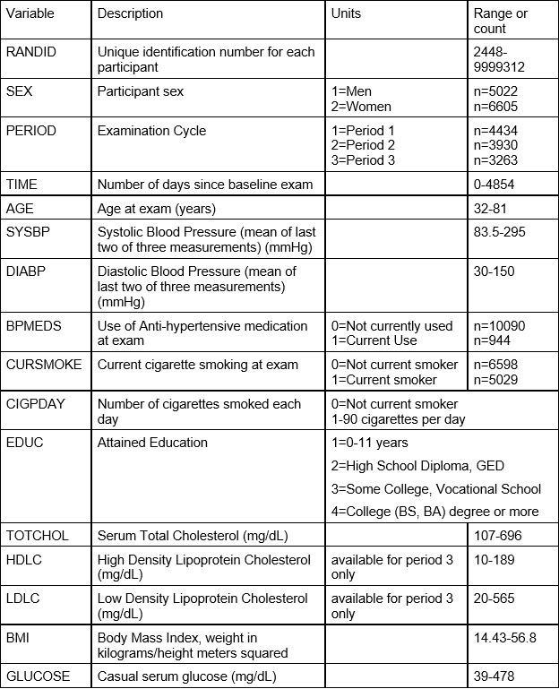
Health Indicators Used

Slide 3
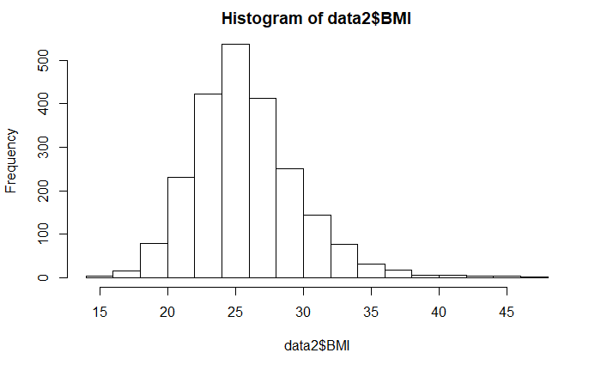
Distribution of the original BMI data

Slide 4
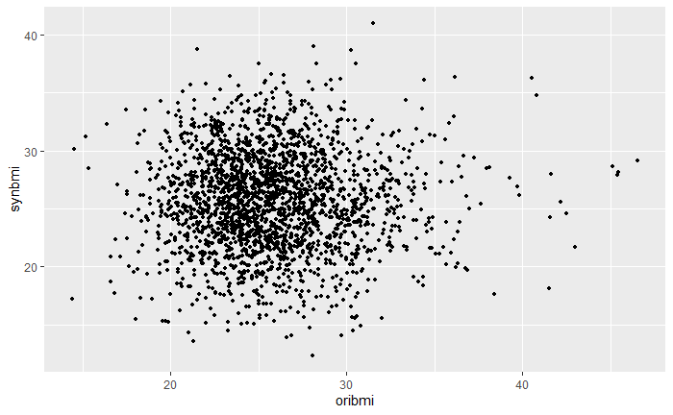
Synthetic model built using the continuous health indicators

Slide 5
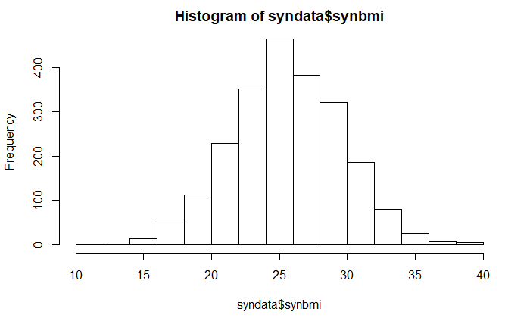
Distribution of synthetic dataset (continuous)

Slide 6
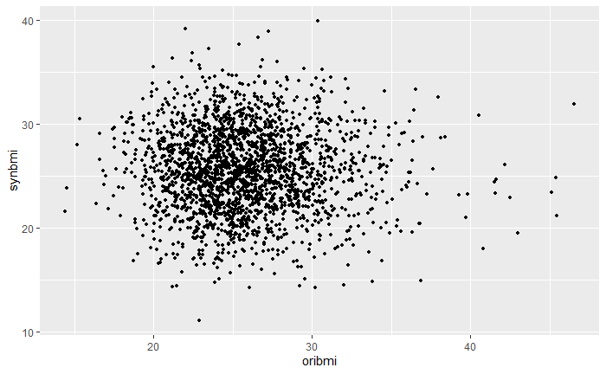
Synthetic model built using the discrete health indicators

Slide 7
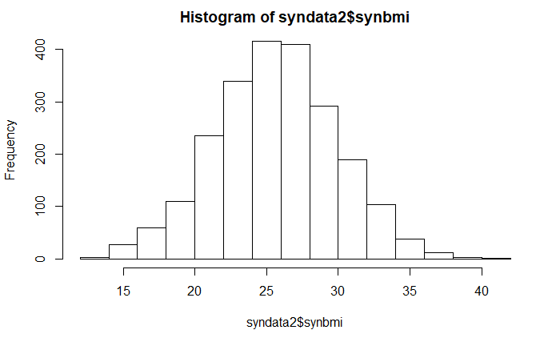
Distribution of synthetic dataset (categorical)

Slide 8
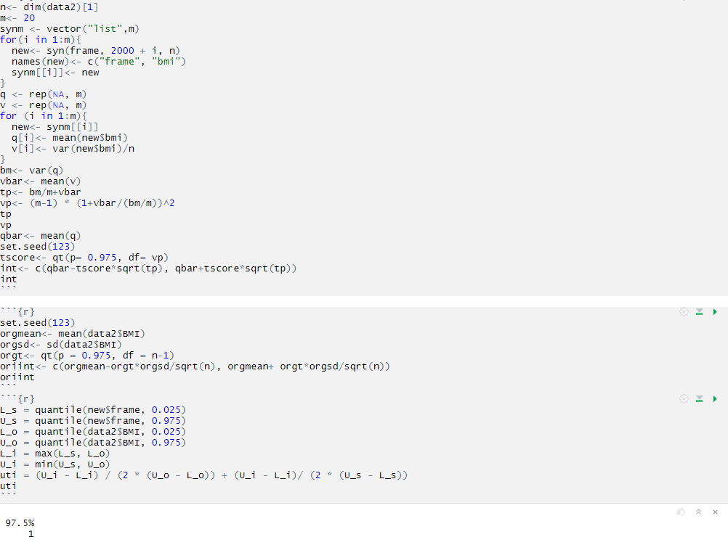
Utility Evaluation

Slide 9
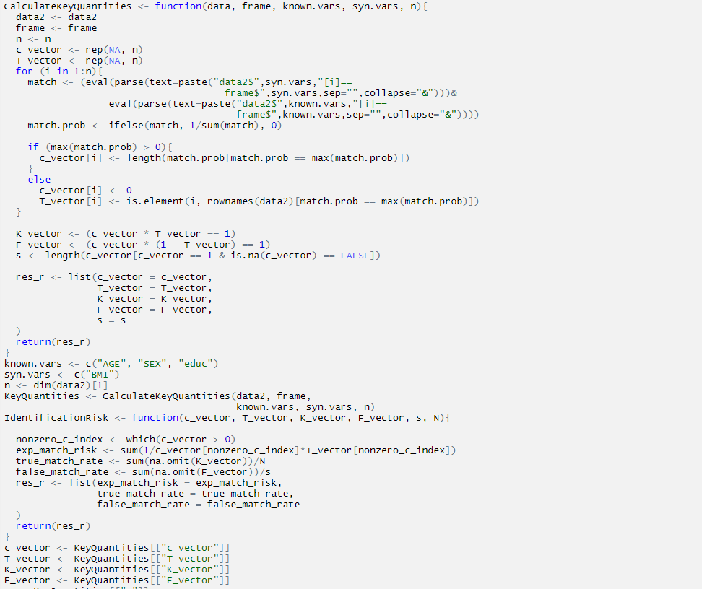
Risk Evaluation

